Slide 1
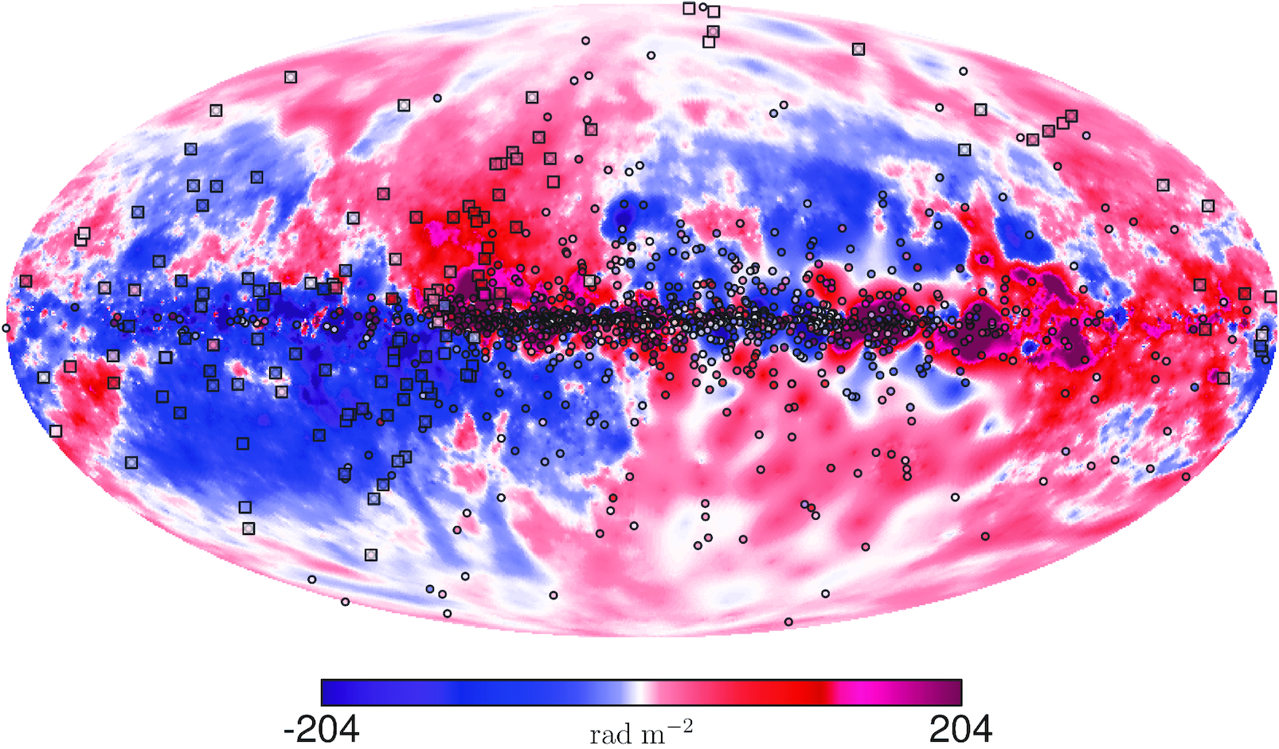
Modelling Faraday Rotations and the Galactic Magnetic Field
George Tso
Image courtesy of Sobey et al.

Slide 2
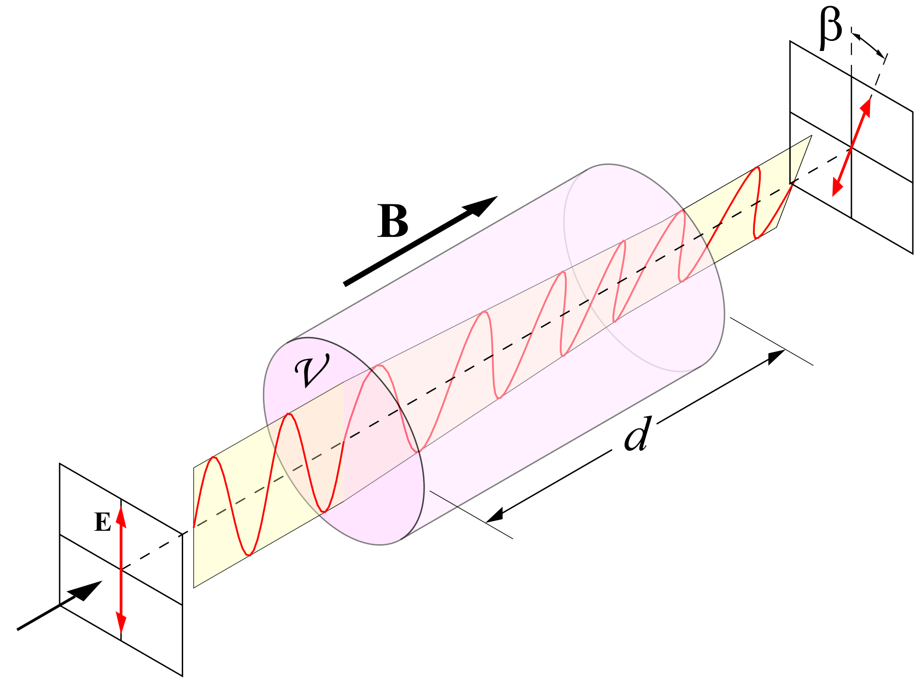
Faraday Rotations in the Interstellar Medium
A phenomenon that helped first prove that light was of an electromagnetic nature
Light propagating through a magnetic field is circularly polarized so long as it stays parallel to the magnetic field lines.

Slide 3

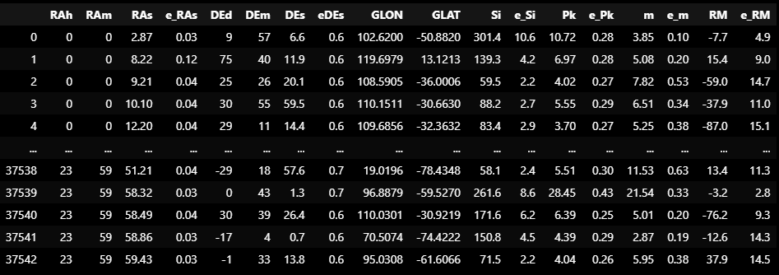
The Data

Slide 4
Measurements & Units
Header Acronym | Measurement | Units
RA | Right Ascension | hrs, min, s
DE | Declination | °, ‘, “
GLON/LAT | Galactic Longitude/Latitude | °
Si | Integrated NVSS Stokes I Flux | mJy
Pk | Average peak polarized intensity | mJy
m | ratio of Pk to Si | %
RM | Rotation Measure | rad/m²

Slide 5
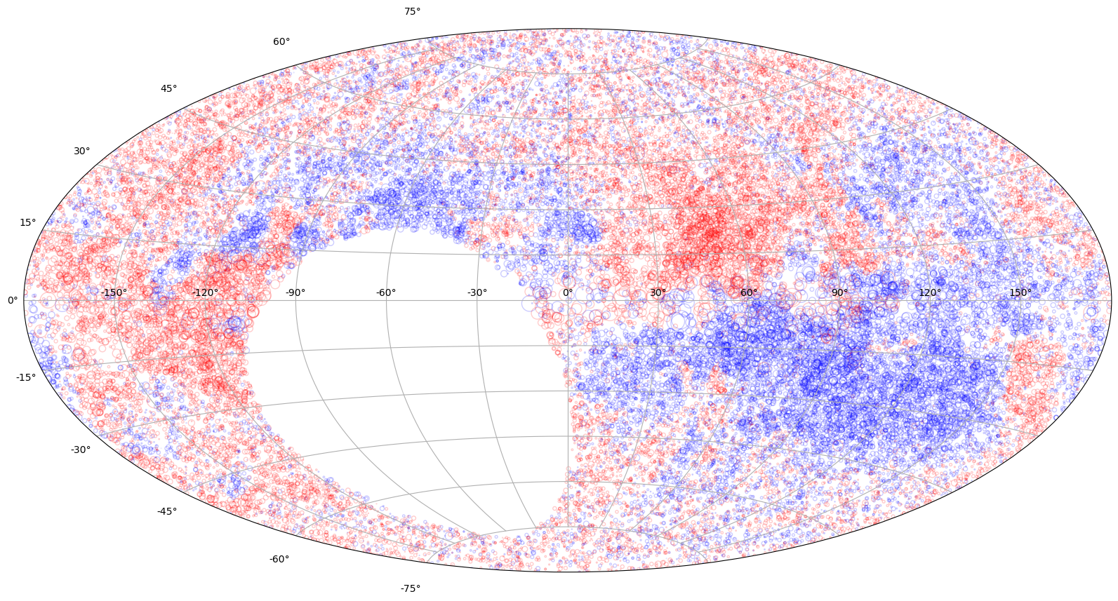
What do we want
A plot of Rotation Measures
Red = RM > 0
Blue = RM < 0
Size = Magnitude of the RM (linear scale)
What’s with the big hole in the sky?

Slide 6
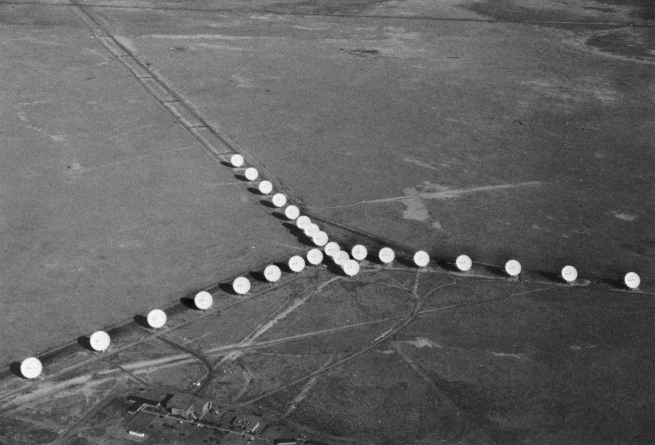
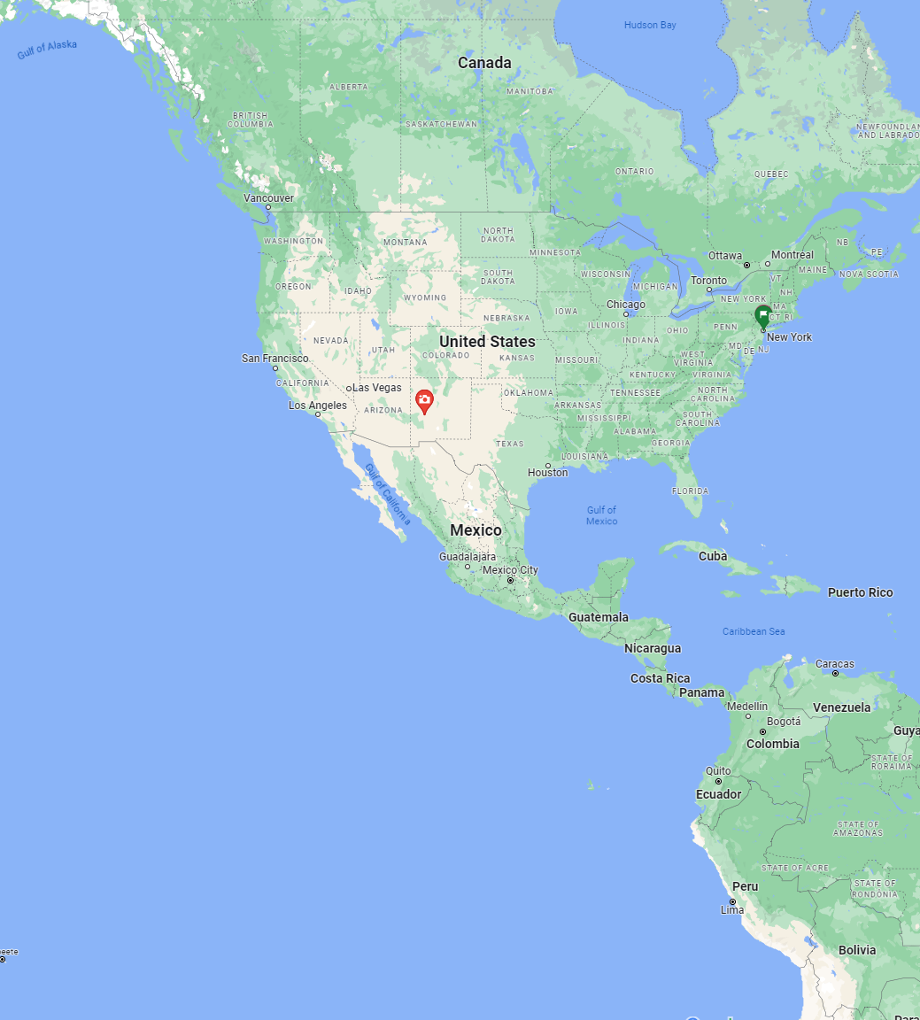
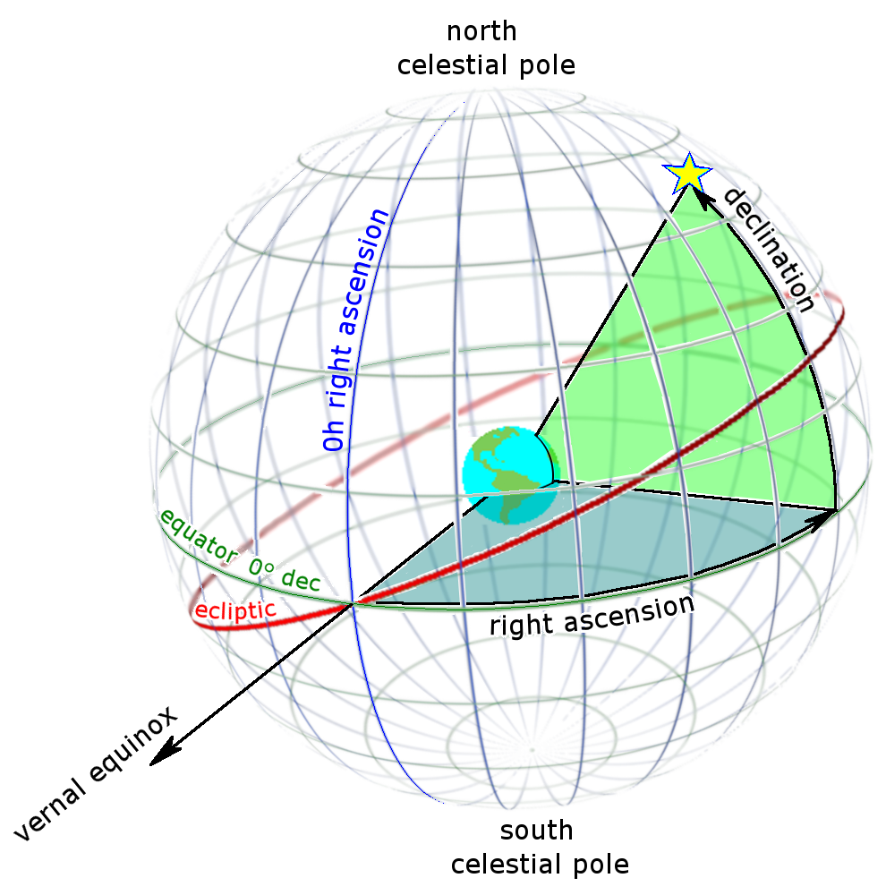
NVSS:
National Radio Astronomy Observatory (NRAO) Very Large Array (VLA) Sky Survey
Modelling Faraday Rotations and the Galactic Magnetic Field

Slide 7
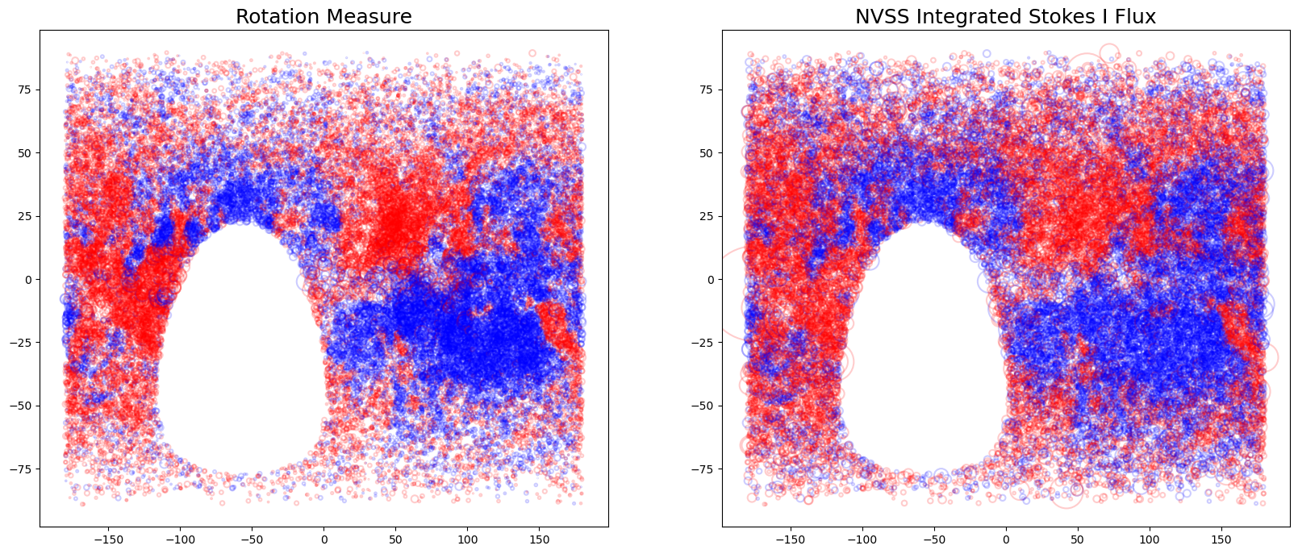
Analysis
According to the original paper, they derived the RM values from the NVSS data.
So let’s plot them separately and see the differences.
Promising?

Slide 8
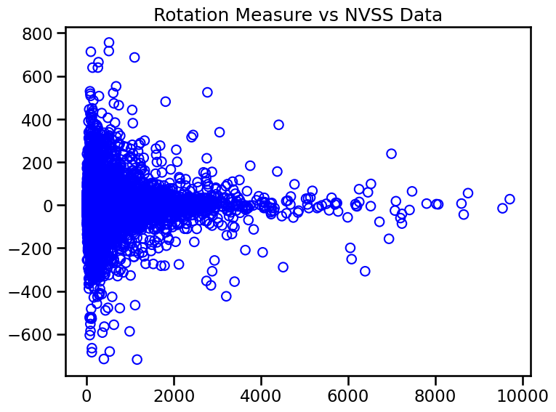
Analysis
Check linearity between Si and RM
Not very promising…
Linear Regression
Logistic Regression
Decision Tree

Slide 9
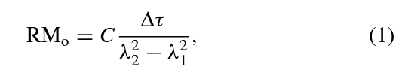
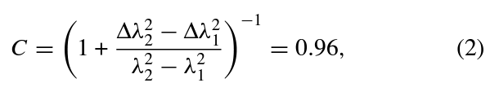
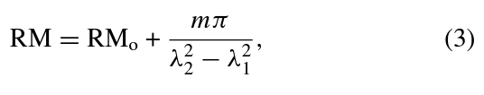
Analysis
How did Taylor et al do it at UCalgary?
“For each source, we derived the median value of RM for all other sources within a radius of 3◦. If the RM value of the source differed from the median value in the surrounding area by more than 520, the RM value was corrected by adding or subtracting 652.9.”

Slide 10
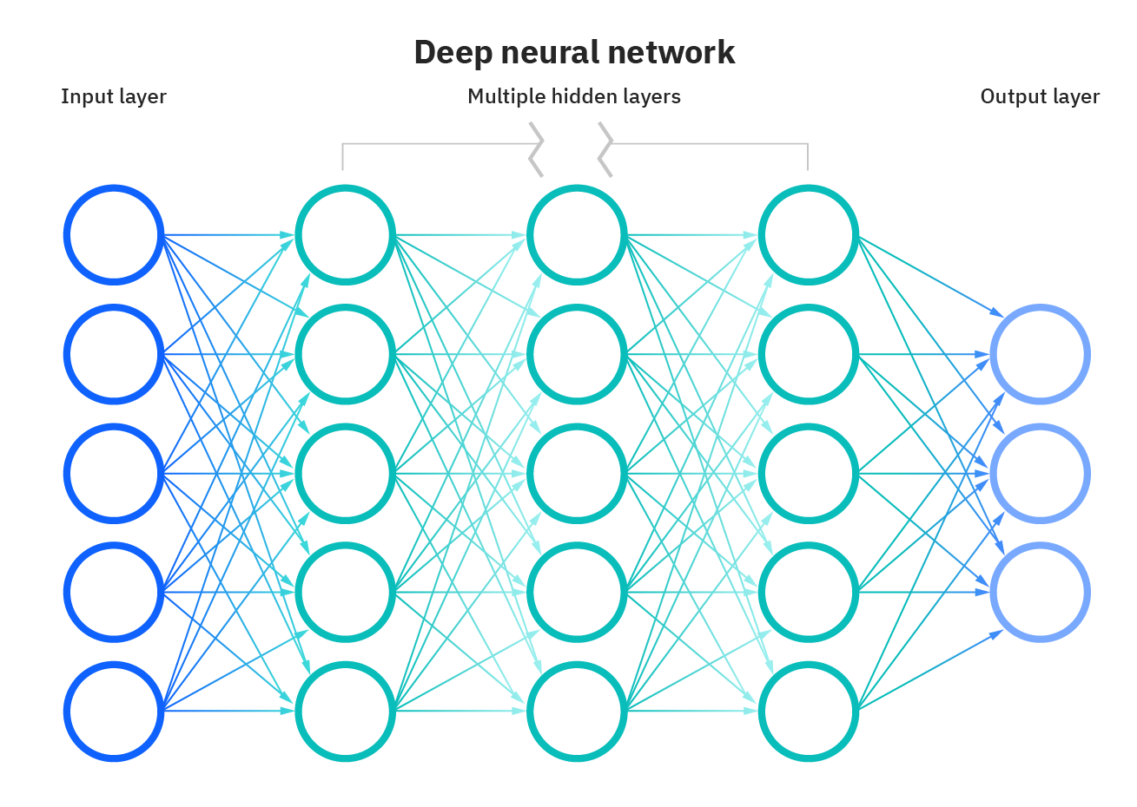


ANN & KNN
Two viable modelling techniques for this project (as far as I know):
Artificial Neural Network
K-Nearest Neighbours Algorithm
Magnitudes of RM
Directions in the RM field as per the original data

Slide 11
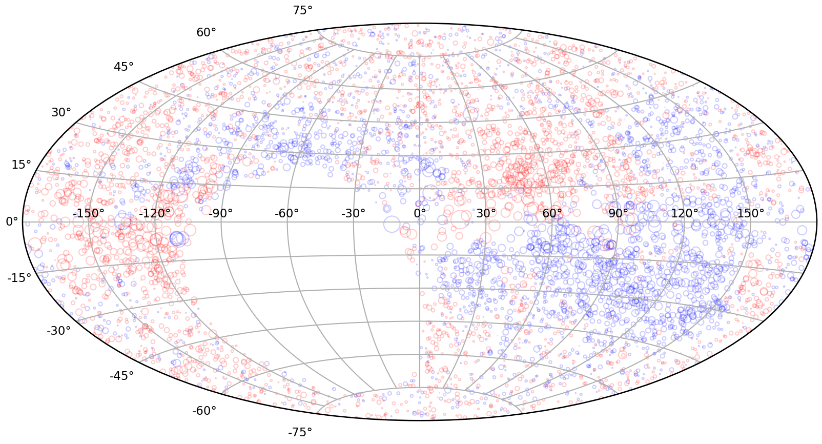
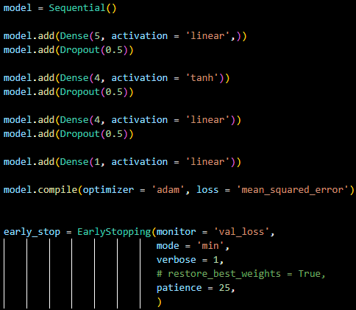
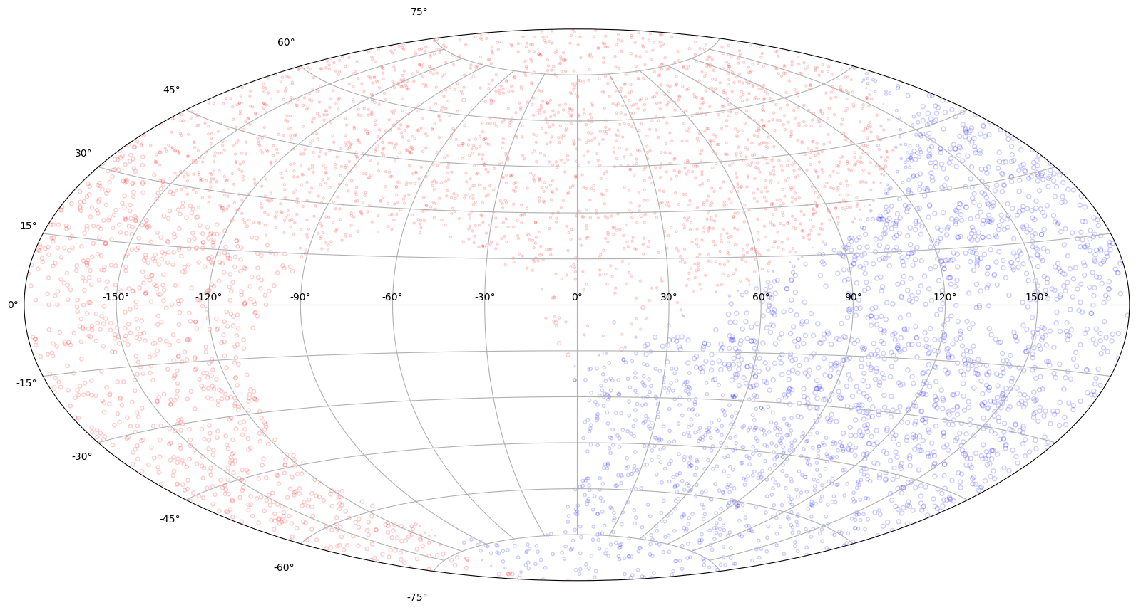
Artificial Neural Network
Not great, only about a quarter of the way there

Slide 12
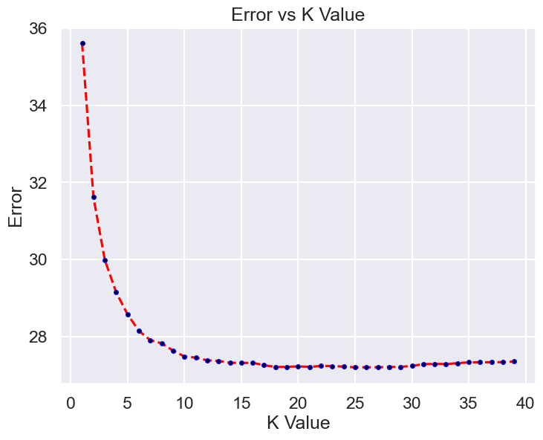
K-Nearest Neighbours
First search for an appropriate K value:

Slide 13
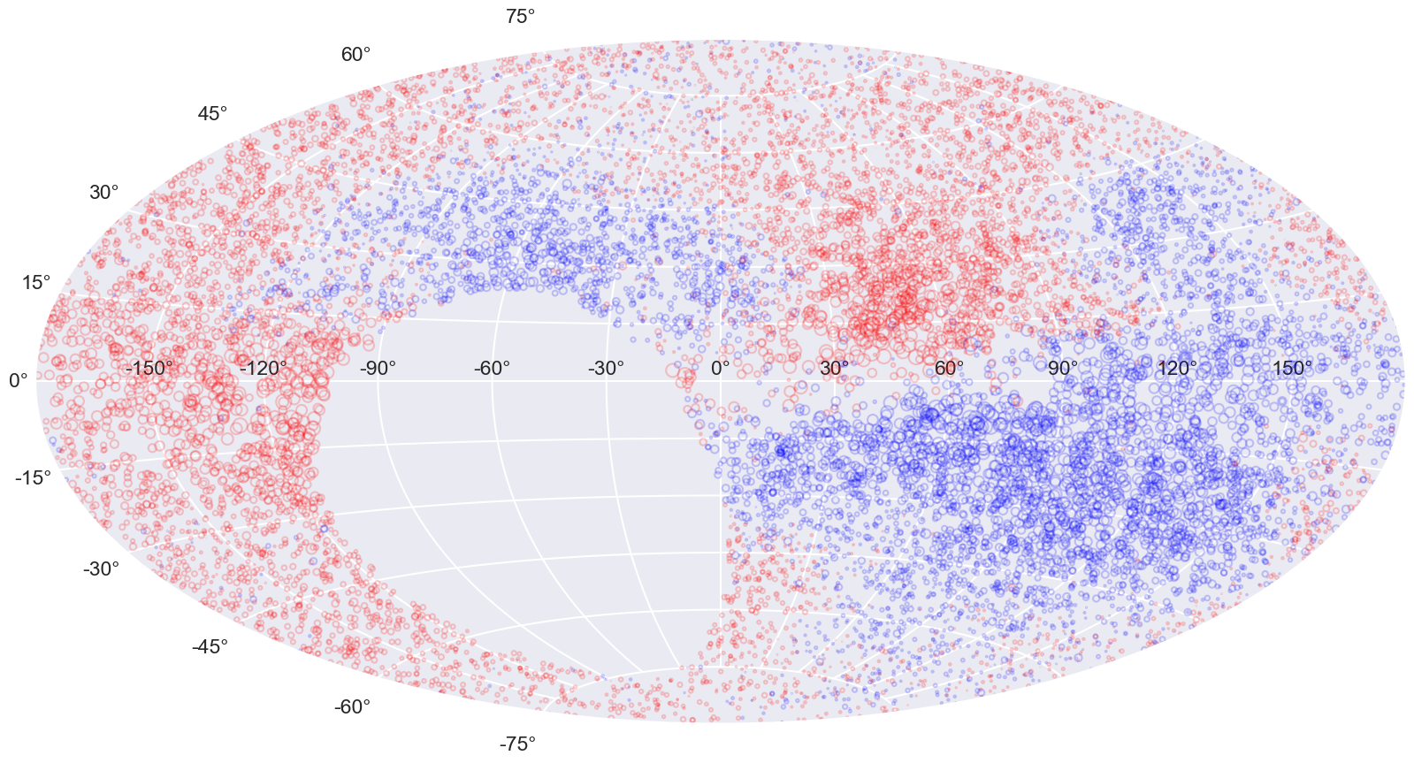
K-Nearest Neighbours
KNN, K = 17

Slide 14
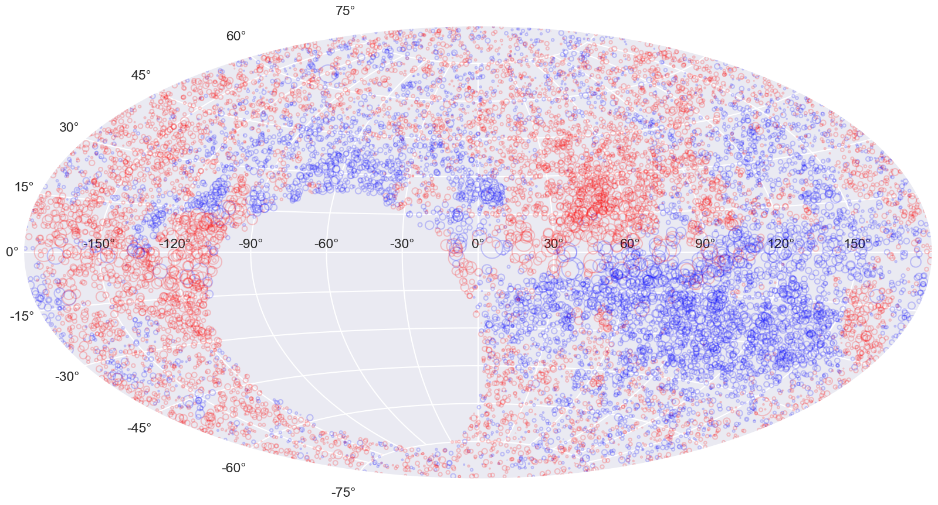
K-Nearest Neighbours
KNN, K = 17
Test Data

Slide 15

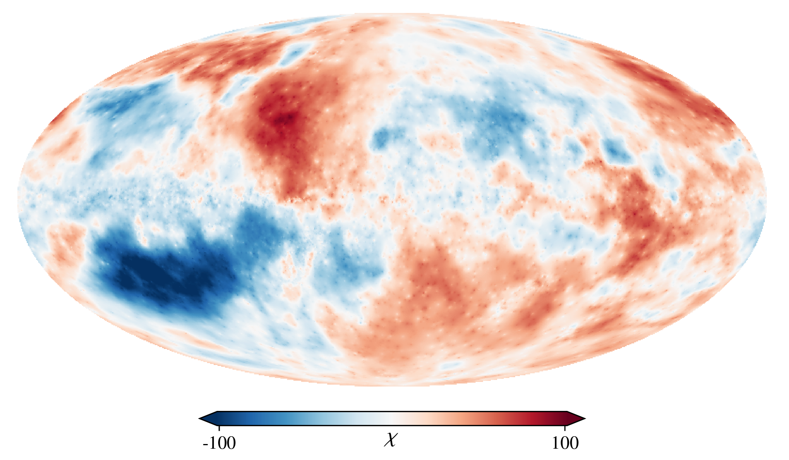
THANK YOU
George Tso

Slide 16
Special Thanks
Special thanks to Prof. Kianoosh Tahani for his expertise and passion for developing such an insightful,well-taught course, as well as finding the dataset used in this project.
References:
Taylor, A. R., Stil, J. M., &amp; Sunstrum, C. (2009). A rotation measure image of the sky. The Astrophysical Journal, 702(2), 1230–1236. https://doi.org/10.1088/0004-637x/702/2/1230
Hutschenreuter, S., Anderson, C. S., Betti, S. K., Crew, G. B., Brown, J. S., Brüggen, M., Carretti, E., Clarke, T. E., Clegg, A., Costa, A. H., Croft, S., Van Eck, C. L., Gaensler, B., De Gasperin, F., Haverkorn, M., Heald, G., Hull, C. L. H., Inoue, M., Johnston-Hollitt, M., . . . Enßlin, T. A. (2021). The Galactic Faraday rotation sky 2020. Astronomy and Astrophysics, 657, A43. https://doi.org/10.1051/0004-6361/202140486

